Slide 1
The Effects of COVID in Middlesex County, New Jersey
By Preston Stringham

Slide 2
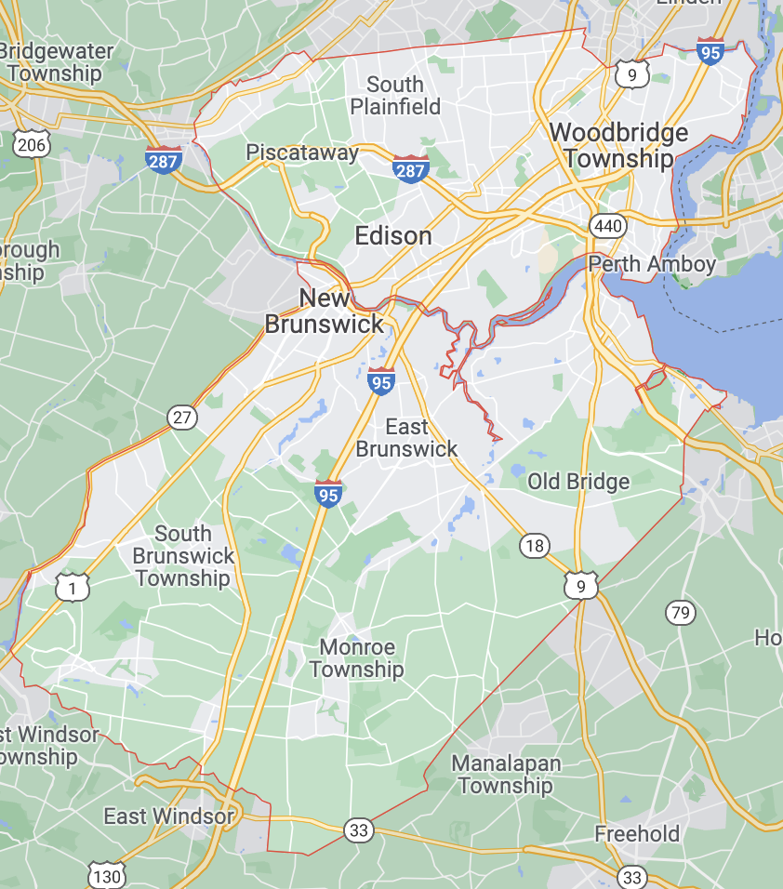
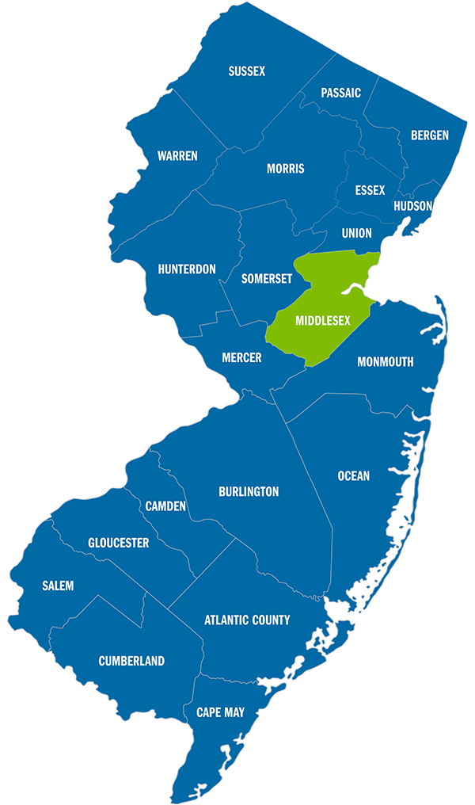
Middlesex Introduction
3 relatively large cities/towns
Total county population: 863,162
5 large hospitals and medical centers
The county looks like the state

Slide 3
Vaccinations and Hospitalizations
Expand on my initial analysis of COVID in Middlesex County
Explore hospitalization data related to Middlesex County
Explore vaccination data and how Middlesex County was influence by the introduction of vaccines

Slide 4
Data
Vaccine Data
CDC
By County
https://healthdata.gov/Hospital/COVID-19-Reported-Patient-Impact-and-Hospital-Capa/anag-cw7u
Hospitalization Data
Healthdata.gov
By Facility
https://data.cdc.gov/Vaccinations/COVID-19-Vaccinations-in-the-United-States-County/8xkx-amqh

Slide 5
What Can I Find Out?
Is there a correlation in vaccination and hospitalizations rates in Middlesex County?
Is therez a difference in the mean change of hospitalization rates between JFK Medical Center and the rest county?

Slide 6
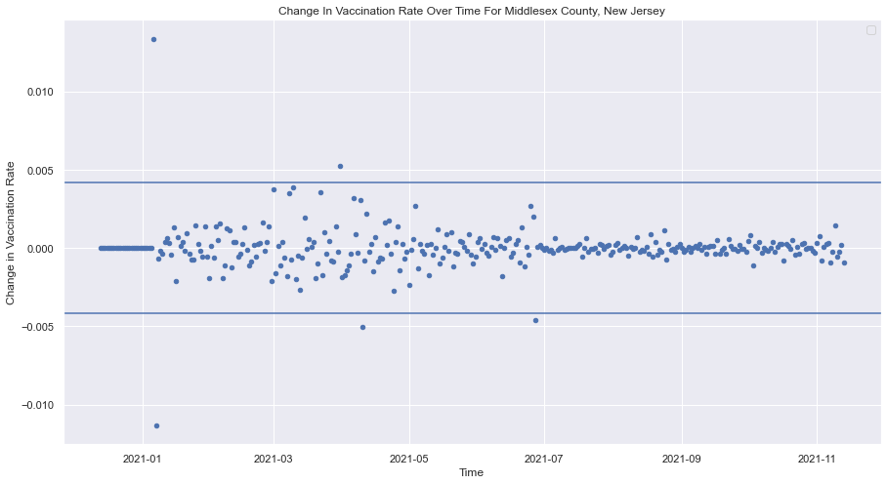
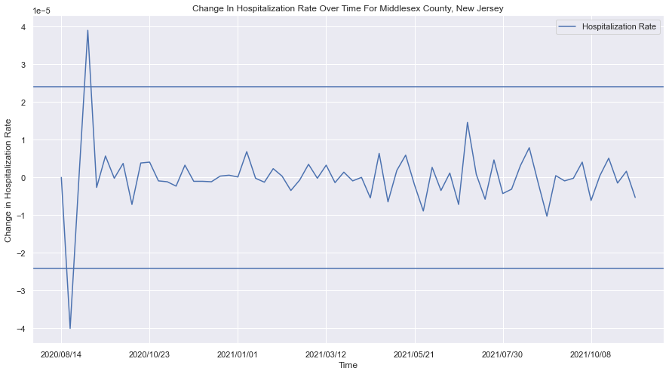
Exploratory Analysis

Slide 7
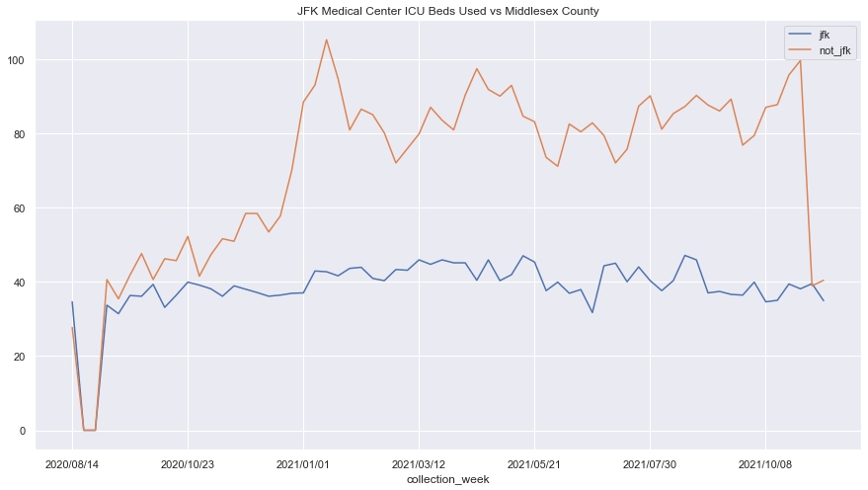
Exploratory Analysis

Slide 8
Methods
Linear Regression
Check null hypothesis and find correlation between vaccination and hospitalization
T-Test
See if there is a difference in average hospitalization among hospitals in the county

Slide 9
Results – Hospitalization vs Vaccination
Is there a correlation in vaccination and hospitalizations rates in Middlesex County?
Regression Results
The p-value was not close to zero which indicates that we fail to reject the null hypothesis
There was a slight positive correlation between the two variables
P-value=0.431 (n=45)

Slide 10
Results – JFK vs Middlesex County
Is there a difference in the mean change of hospitalization rates between JFK Medical Center and the rest county?
T-Test Results
The p-value from my T-Test was large indicating that we cannot reject the null hypothesis
P-value=0.91 (n=45)

Slide 11
Interpretation
Hospitalization vs Vaccination
We fail to reject the null hypothesis
The regression indicates that there was no significance between the correlations
There is no difference in mean hospitalization rate between JFK Medical Center and the rest of the county
We fail to reject the null hypothesis
The T-Test indicates that there was no significance in the difference in mean hospitalization rate between JFK Medical Center and the rest of the county

Slide 12
Conclusion
This analysis provides us with more insight into COVID in Middlesex County
Still many factors that influence the spread of COVID

